Slide 1
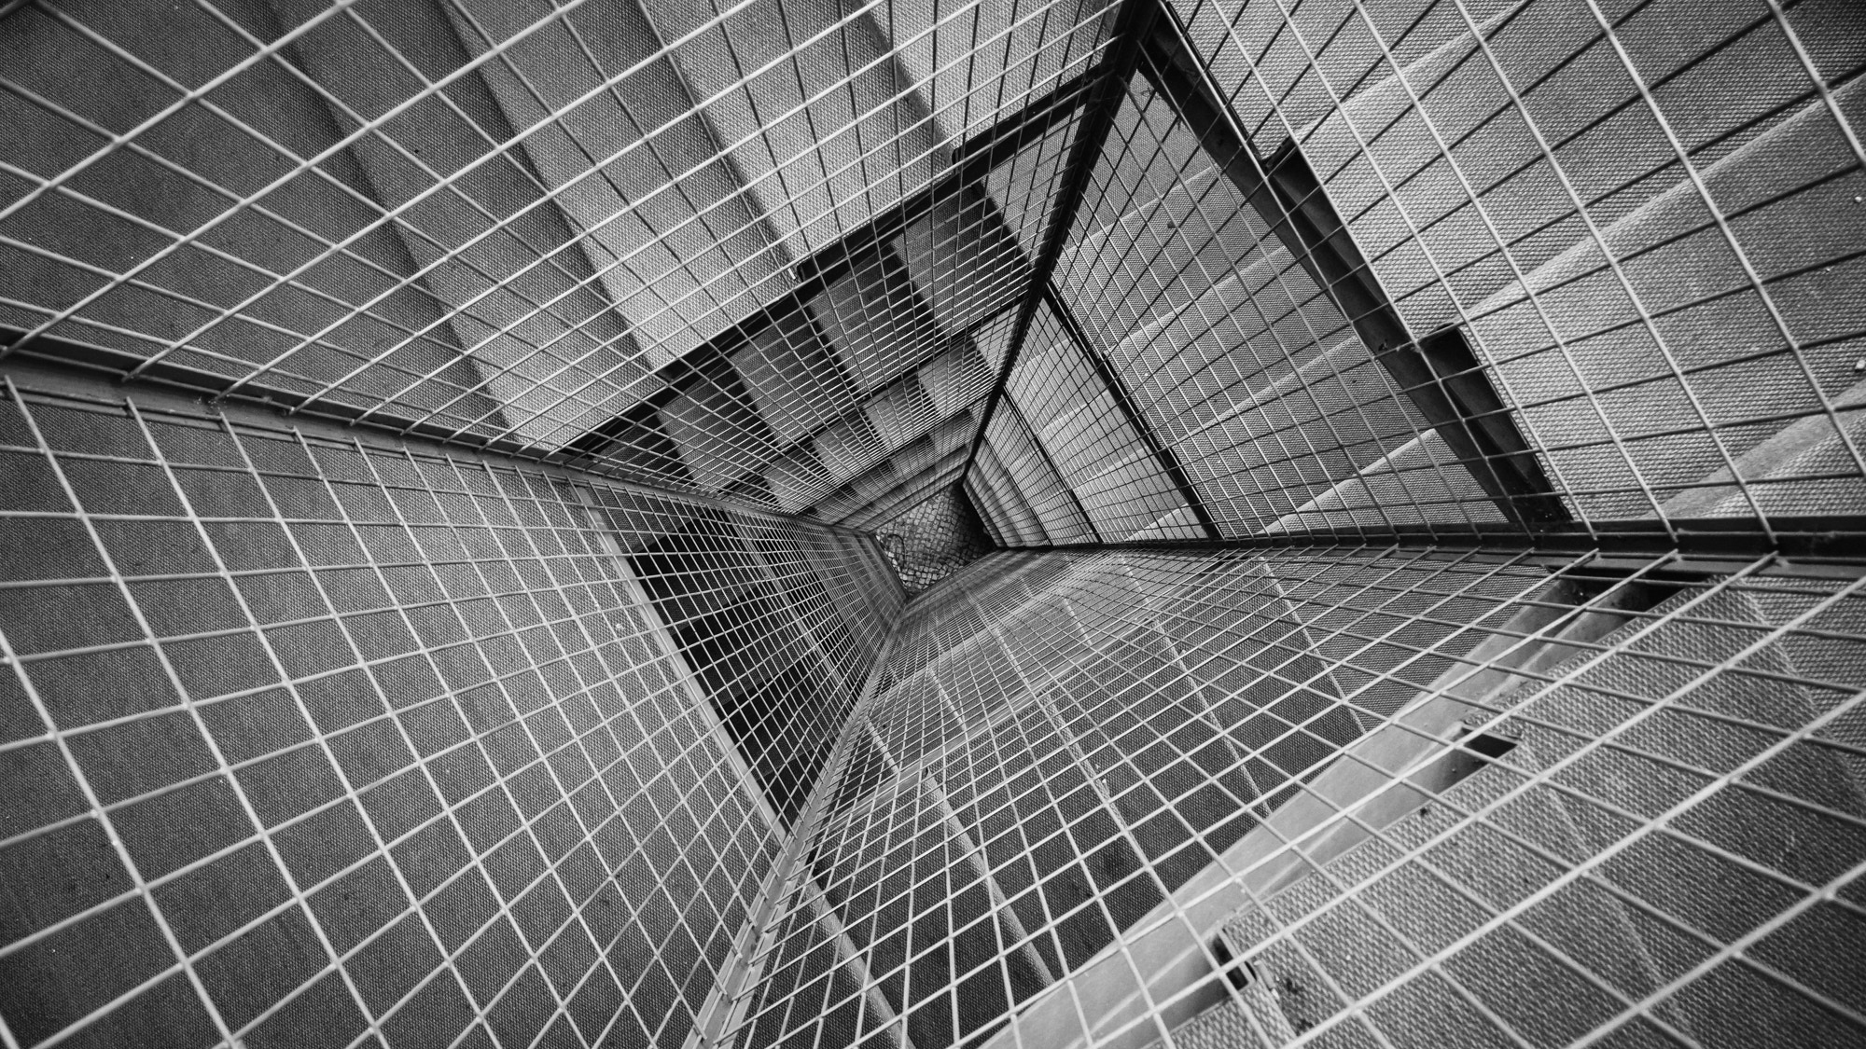
TOTAL TECHNOLOGY
REPORTLAB COMPLETE TUTORIAL

Slide 2

REPORTLAB Platypus
TUTORIAL 16
TOTAL TECHNOLOGY

Slide 3

WHAT IS Platypus
INTRODUCTION TO PLATYPUS
TOTAL TECHNOLOGY

Slide 4
WHAT IS PLATYPUS
DEFENITION
Platypus stands for "Page Layout and Typography Using Scripts".
It is a high level page layout library which lets you programmatically create complex documents with a minimum of effort.
The overall design of Platypus can be thought of has having several layers, top down, these are
DocTemplates the outermost container for the document;
PageTemplates specifications for layouts of pages of various kinds;
Frames specifications of regions in pages that can contain flowing text or graphics.
Flowables text or graphic elements that should be "flowed into the document (i.e. things like images, paragraphs and tables, but not things like page footers or fixed page graphics).
pdfgen.Canvas the lowest level which ultimately receives the painting of the document from the other layers.
TOTAL TECHNOLOGY

Slide 5
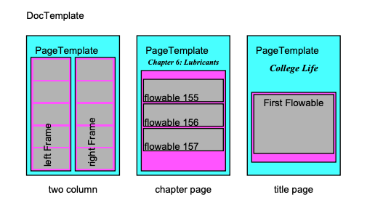
WHAT IS Platypus
The illustration above graphically illustrates the concepts of DocTemplates, PageTemplates and Flowables. It is deceptive, however, because each of the
PageTemplates actually may specify the format for any number of pages (not just one as might be inferred from the diagram). DocTemplates contain one or more PageTemplates each of which contain one or more Frames. Flowables are things which can be flowed into a Frame e.g. a Paragraph or a Table. To use platypus you create a document from a DocTemplate class and pass a list of Flowables to its build method. The document build method knows how to process the list of flowables into something reasonable.
Illustration of DocTemplate structure
TOTAL TECHNOLOGY

Slide 6
SAMPLE CODE uploaded to GitHub https://github.com/youtubetotaltechnology/source/blob/master/reportlab_tutorial_16.py https://github.com/youtubetotaltechnology/source/blob/master/reportlab_tutorial_16.py
TOTAL TECHNOLOGY

